Slide 1
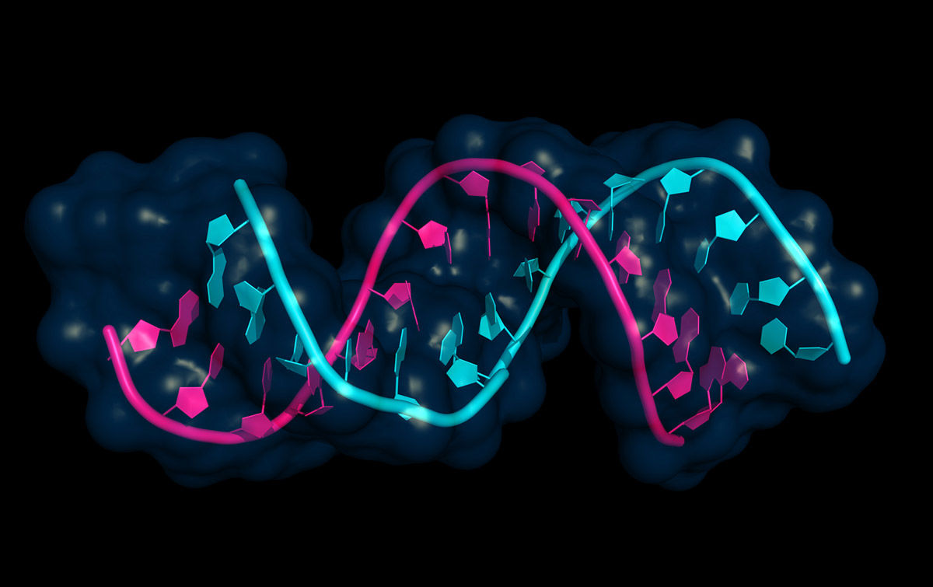
RNA-seq of granulocytes derived from control and AK2 depleted human HSPCs
ILLUSTRATION: © PETARG/SHUTTERSTOCK.COM
Lindsay Reisman & Zunqiu Wang

Slide 2
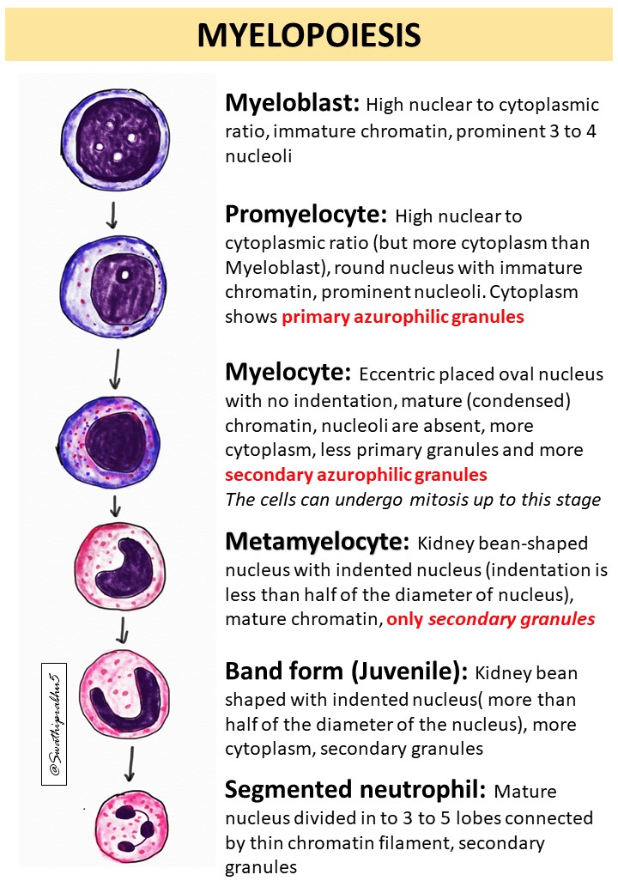
Dataset Summary/Biological Significance
GOAL: understand why AK2 is depleted and how that affects myelopoiesis and its metabolic pathway. Detecting any pattern from the cells would be telling in how they affect any downstream processes they are involved in.
This study focuses on Reticular Dysgenesis (RD) which is a rare but most severe form of severe combined immunodeficiency (SCID).
Affects the development and function of infection-fighting immune cells.
characterized by profound lower levels of neutrophils and lymphocytes (T and Natural killer cells)
Caused by mutations in the AK2 gene
The dataset consists of 2 factors (condition and cell)
2 levels in condition (AAVS1 CRISPR, AK2 CRISPR)
3 levels in cell (Promyelocyte, Myelocyte, Neutrophil).
Notes:
AK2 and AAVS1 (safe harbor control) knock-out Hematopoietic stem and progenitor cells (HSPCs) were differentiated along the granulocytic lineage and cells at different maturation stages
To study the effect of AK2 depletion on HSPC differentiation, we developed a biallelic AK2 CRISPR knock-out model using human HSPCs. AK2 depleted HSPCs display severe proliferation and myeloid differentiation defects, recapitulating RD patient phenotype.

Slide 3
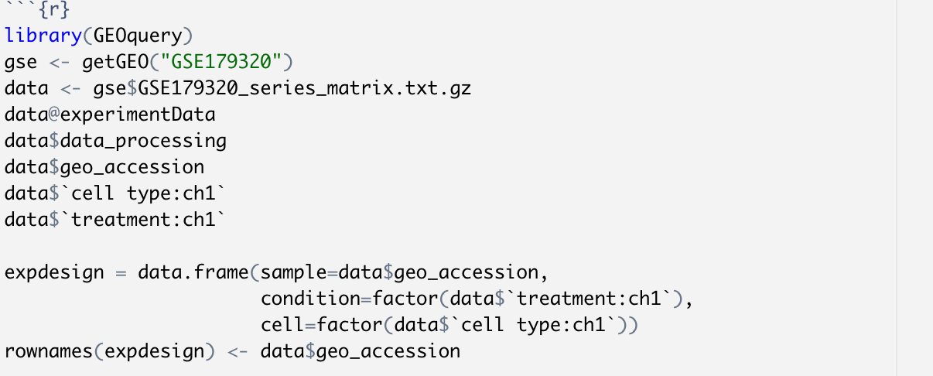
Load in dataset using GEOquery

Slide 4
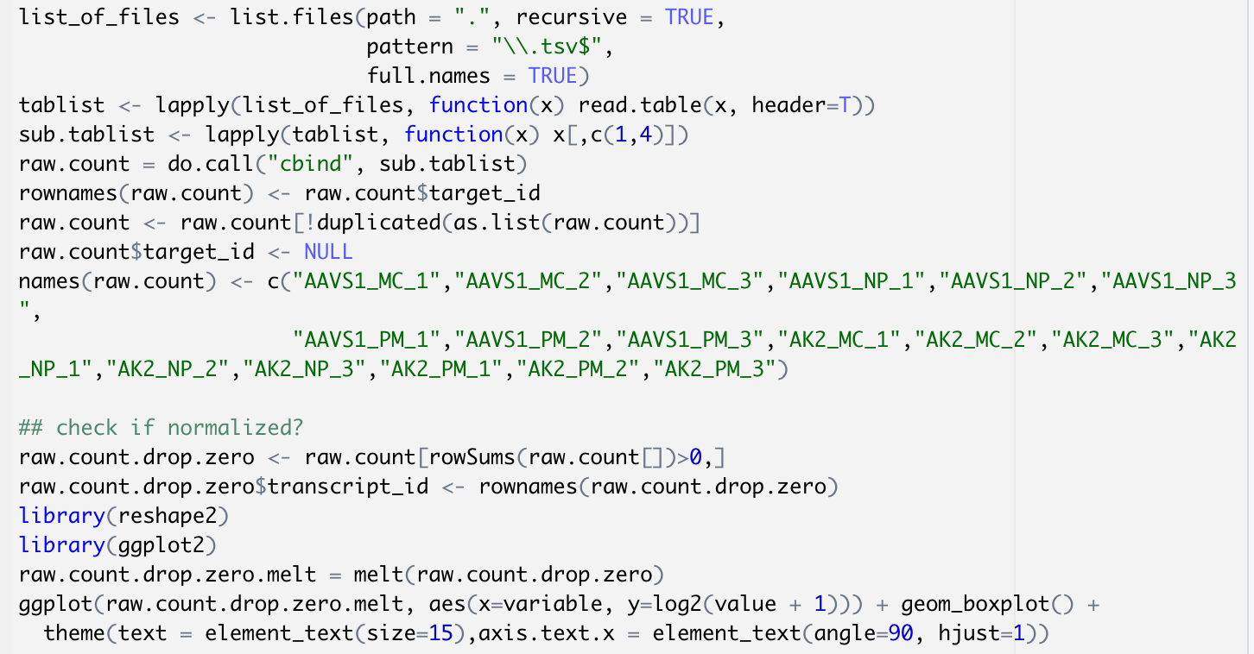
Normalization of Dataset - Methods

Slide 5
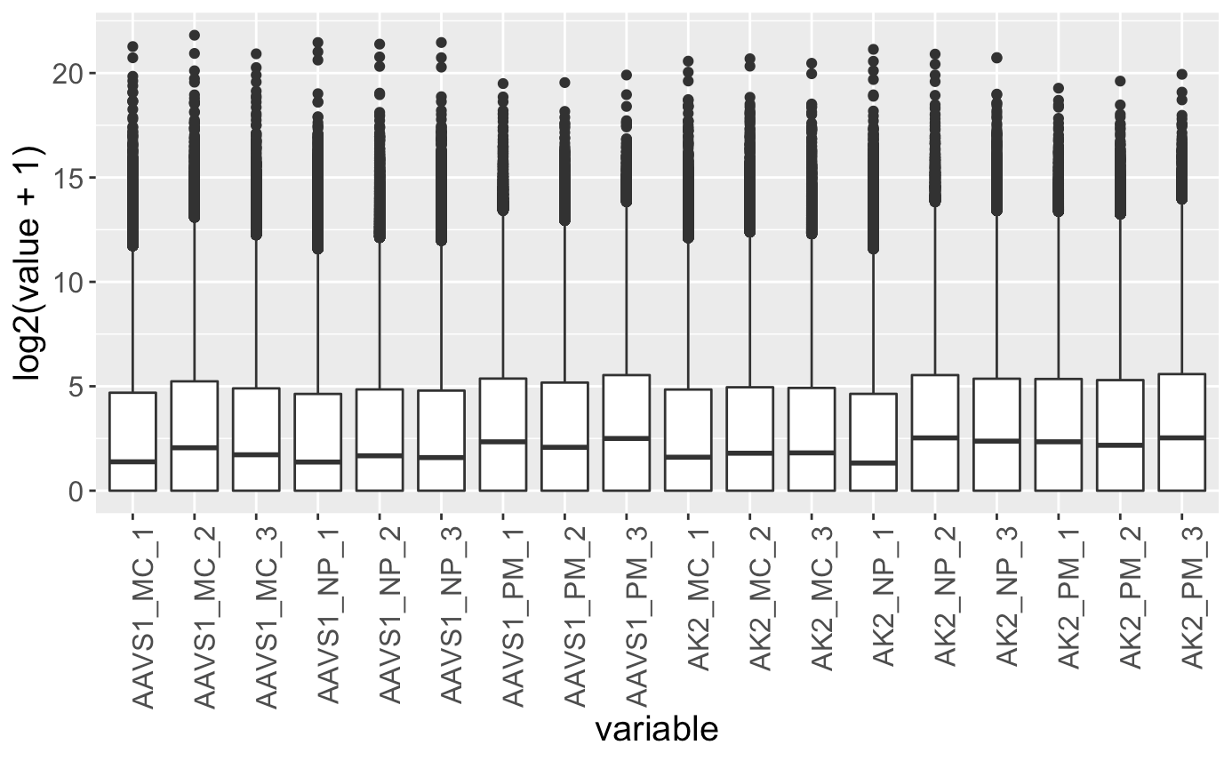
Normalization of Dataset - Results
Notes:
Normalized counts across samples

Slide 6
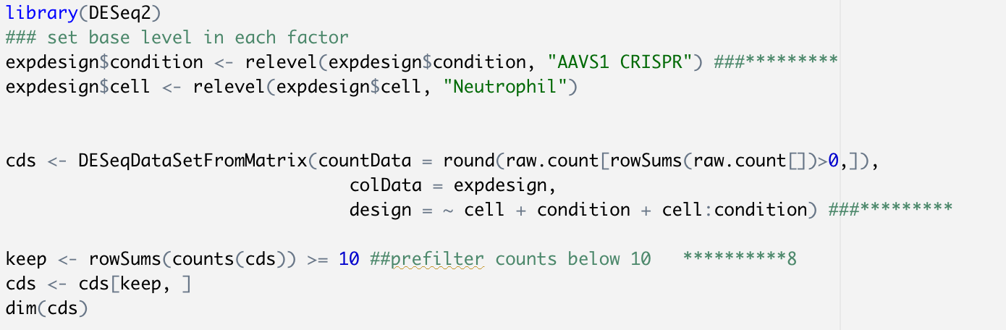
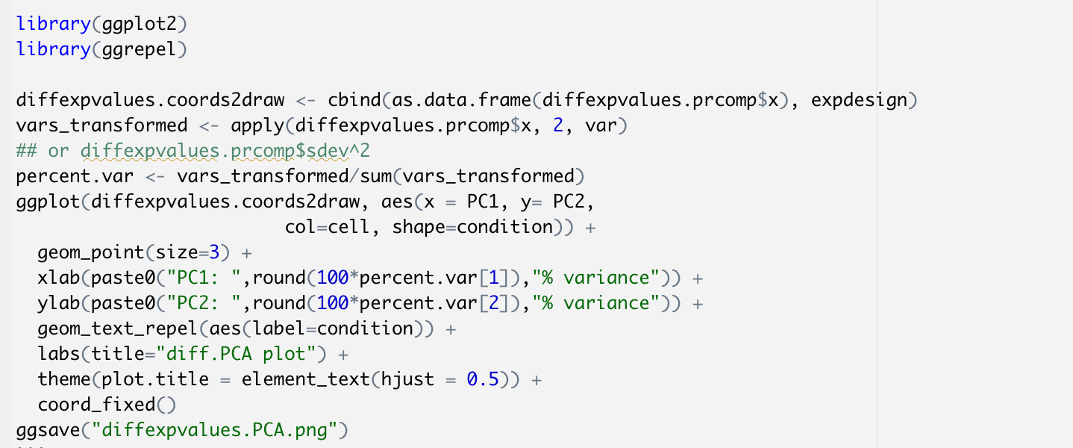
Differentially Expressed Genes - Method

Slide 7
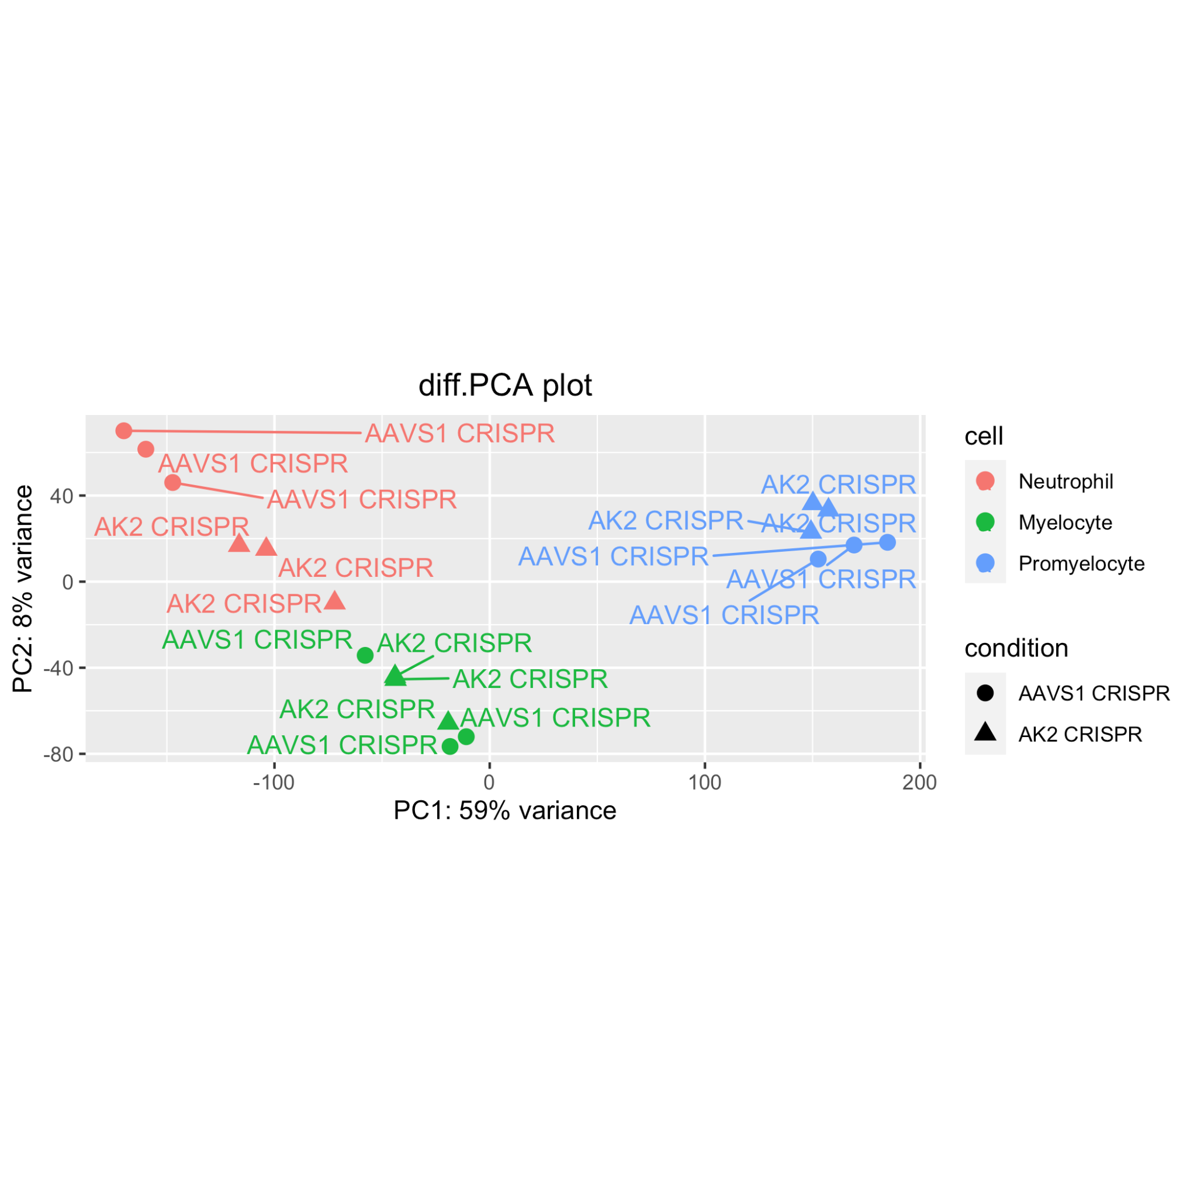
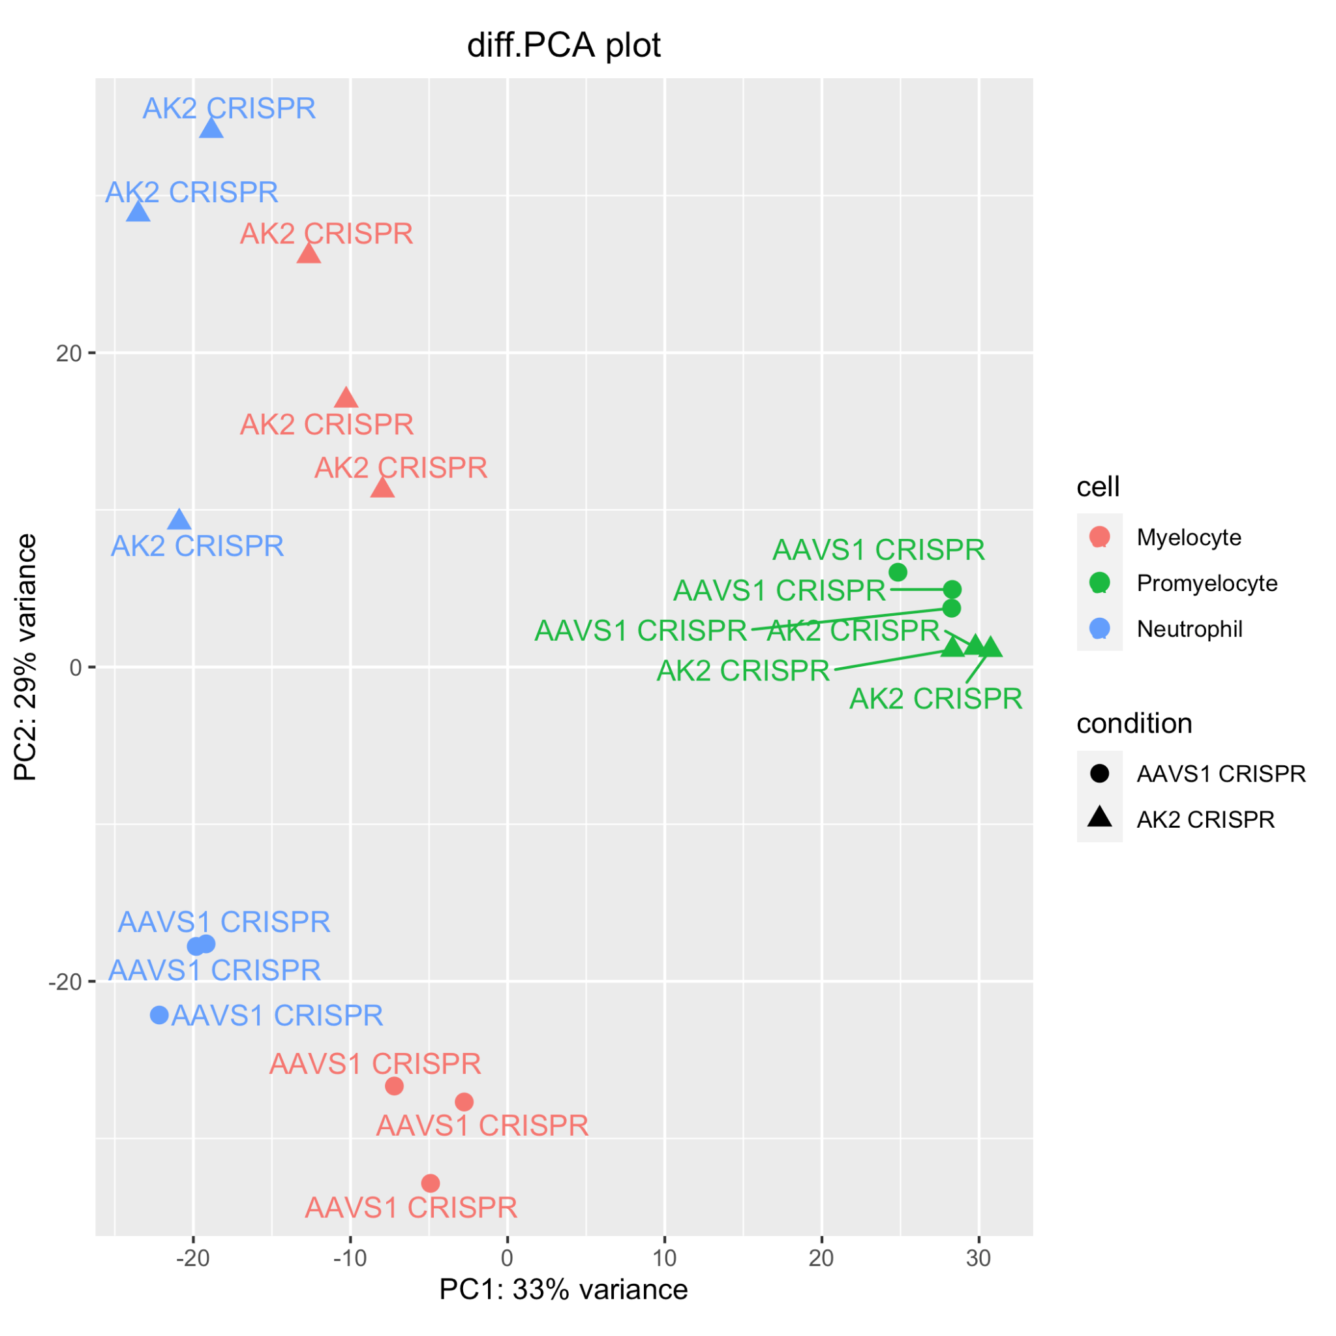
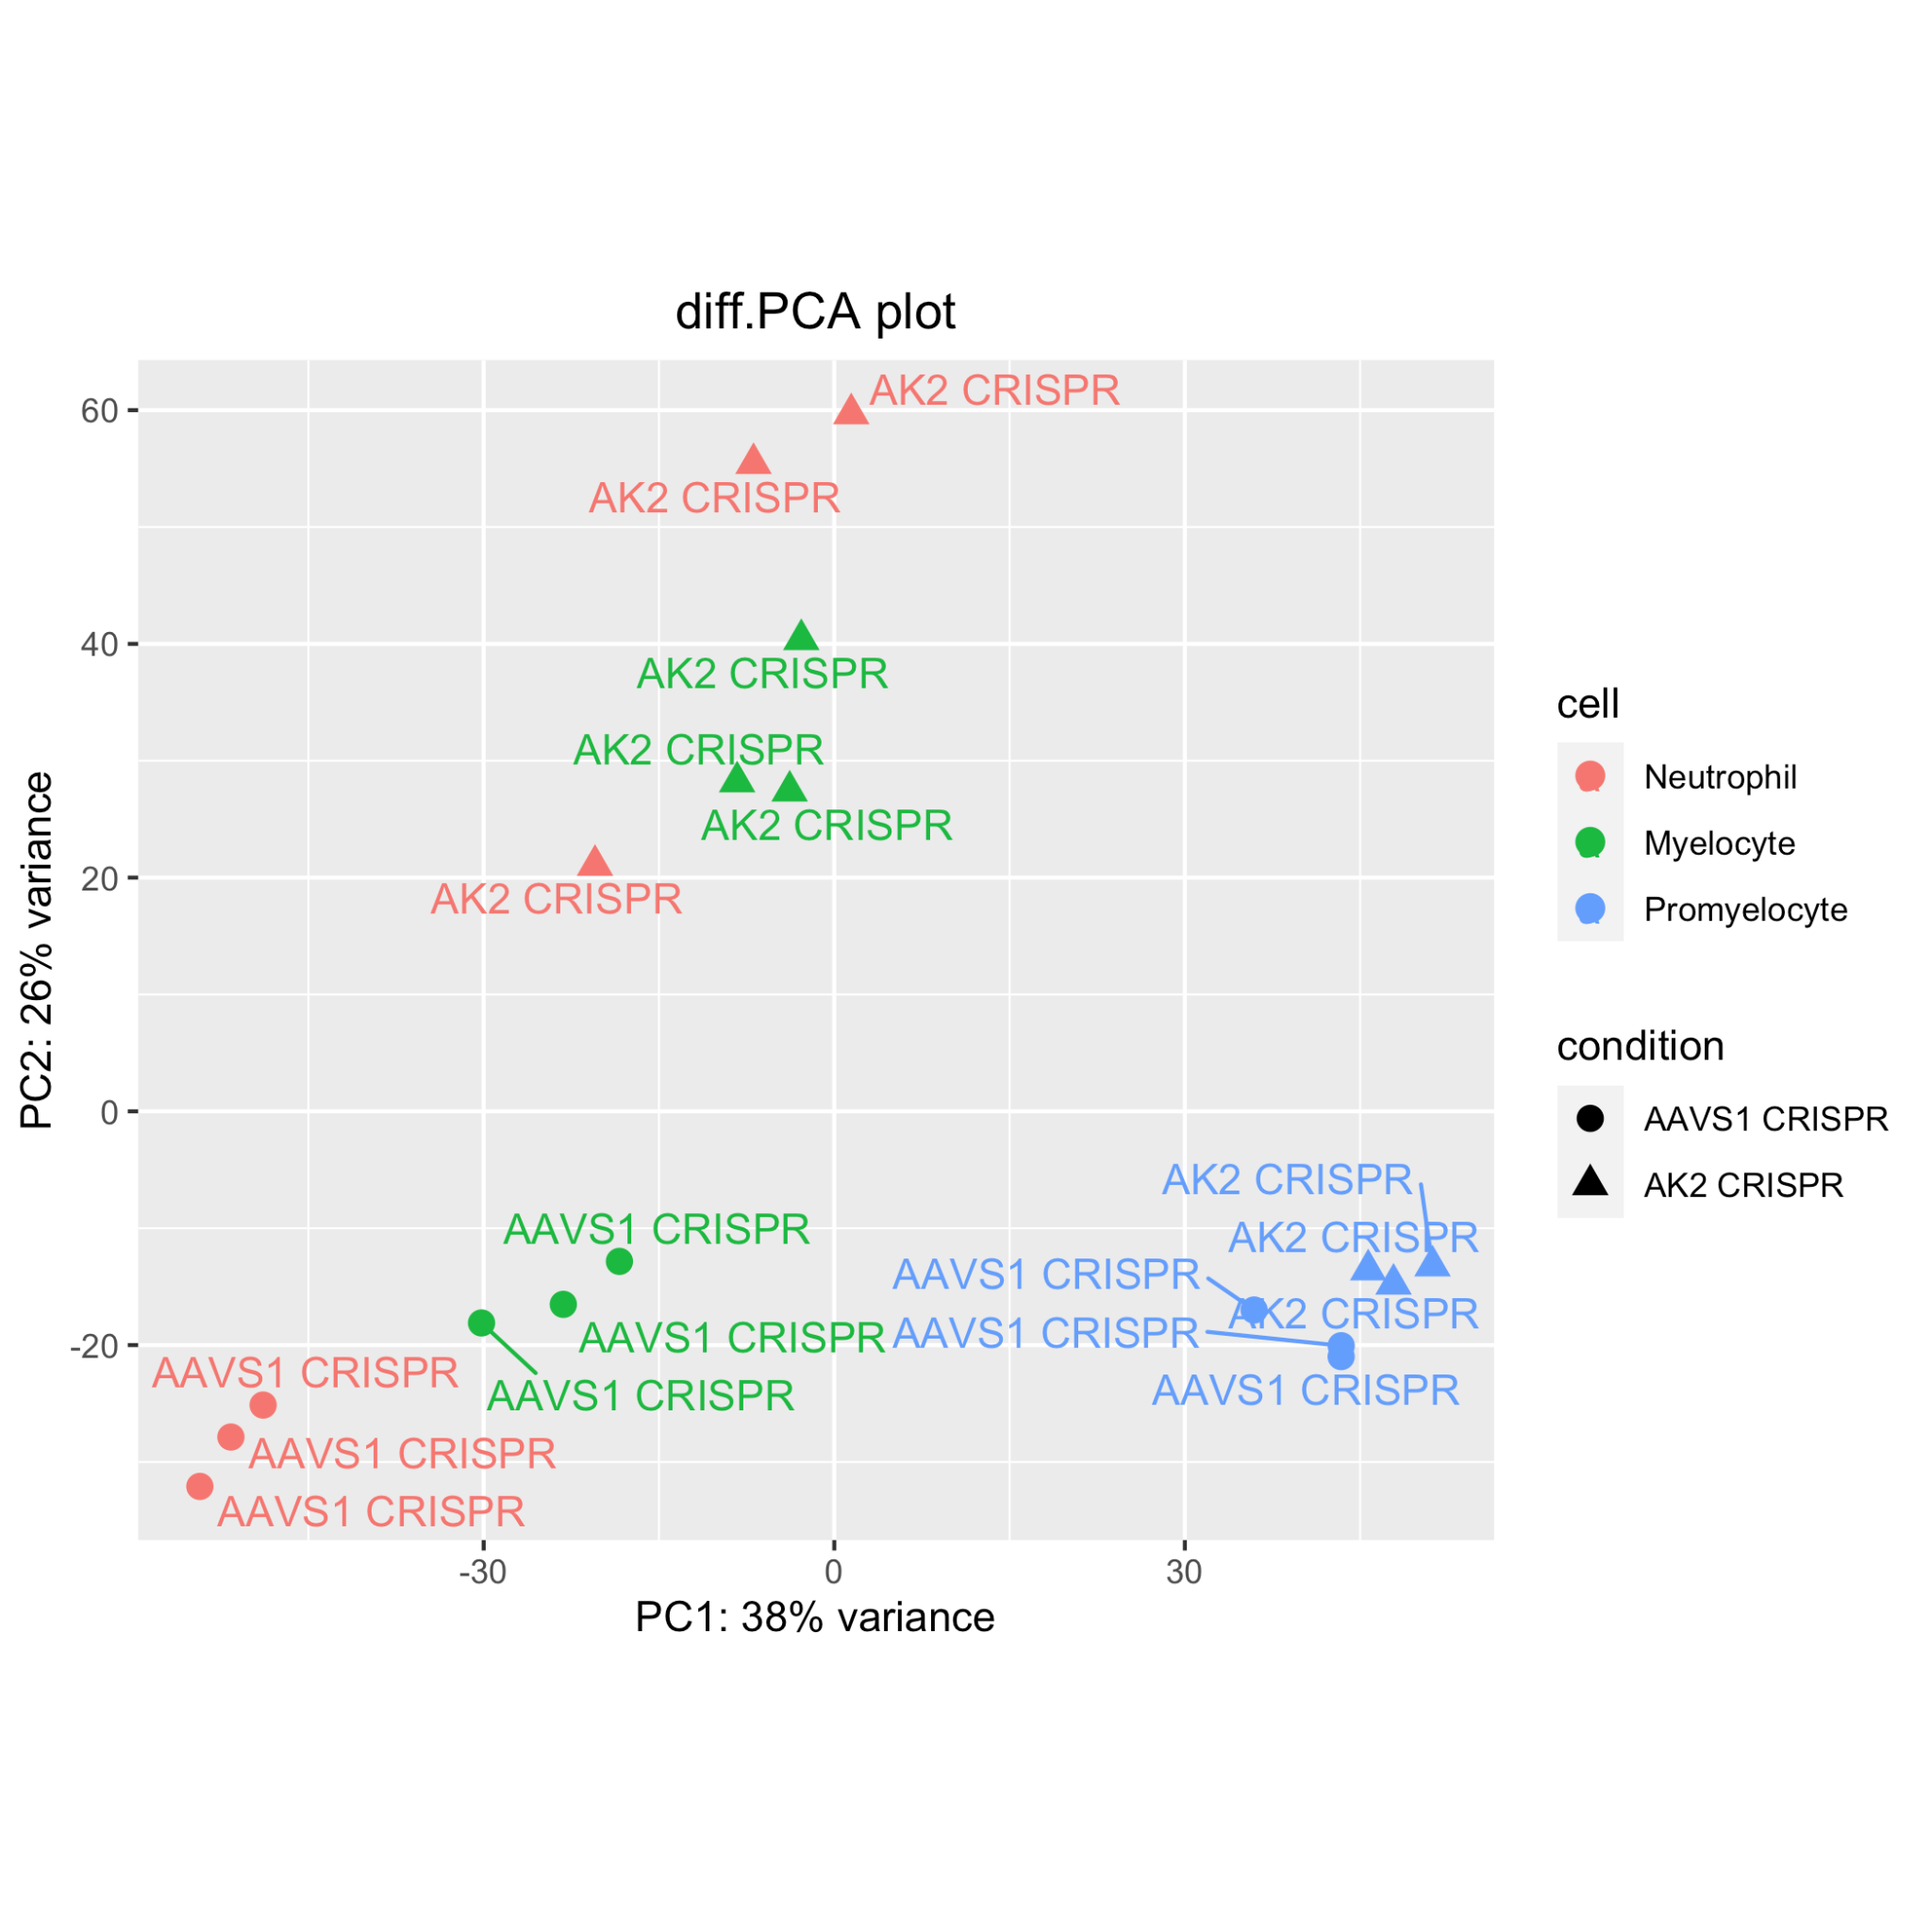
Differentially Expressed Genes- Results
Cell
Interaction
Condition
Notes:
From interaction: PC1 separate pro vs neu + mye accounting for 33%; PC2 separates most AAVS1 vs AK2 with exception for Pro
From Cell: PC1 separates pro vs neu + mye explaining 59% variability; PC2 not clearly
From condition: PC1 separates pro vs neu + mye explaining 38% variability; PC2 separates most AAVS1 vs AK2 with exception for Pro

Slide 8
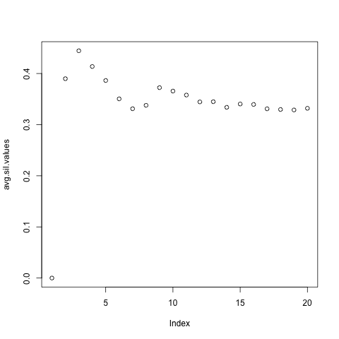
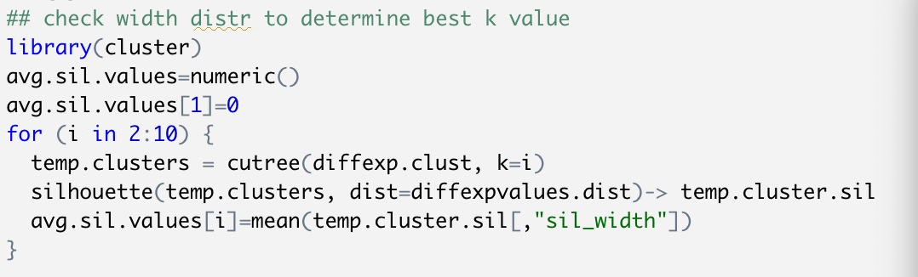
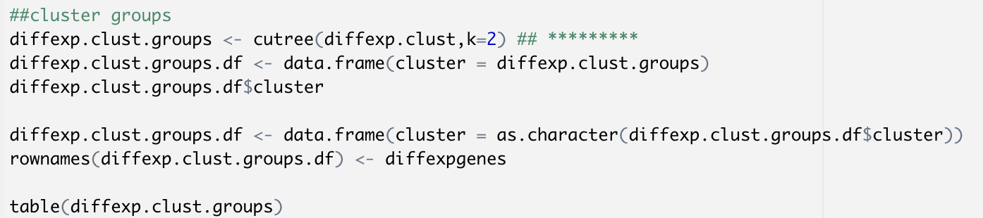
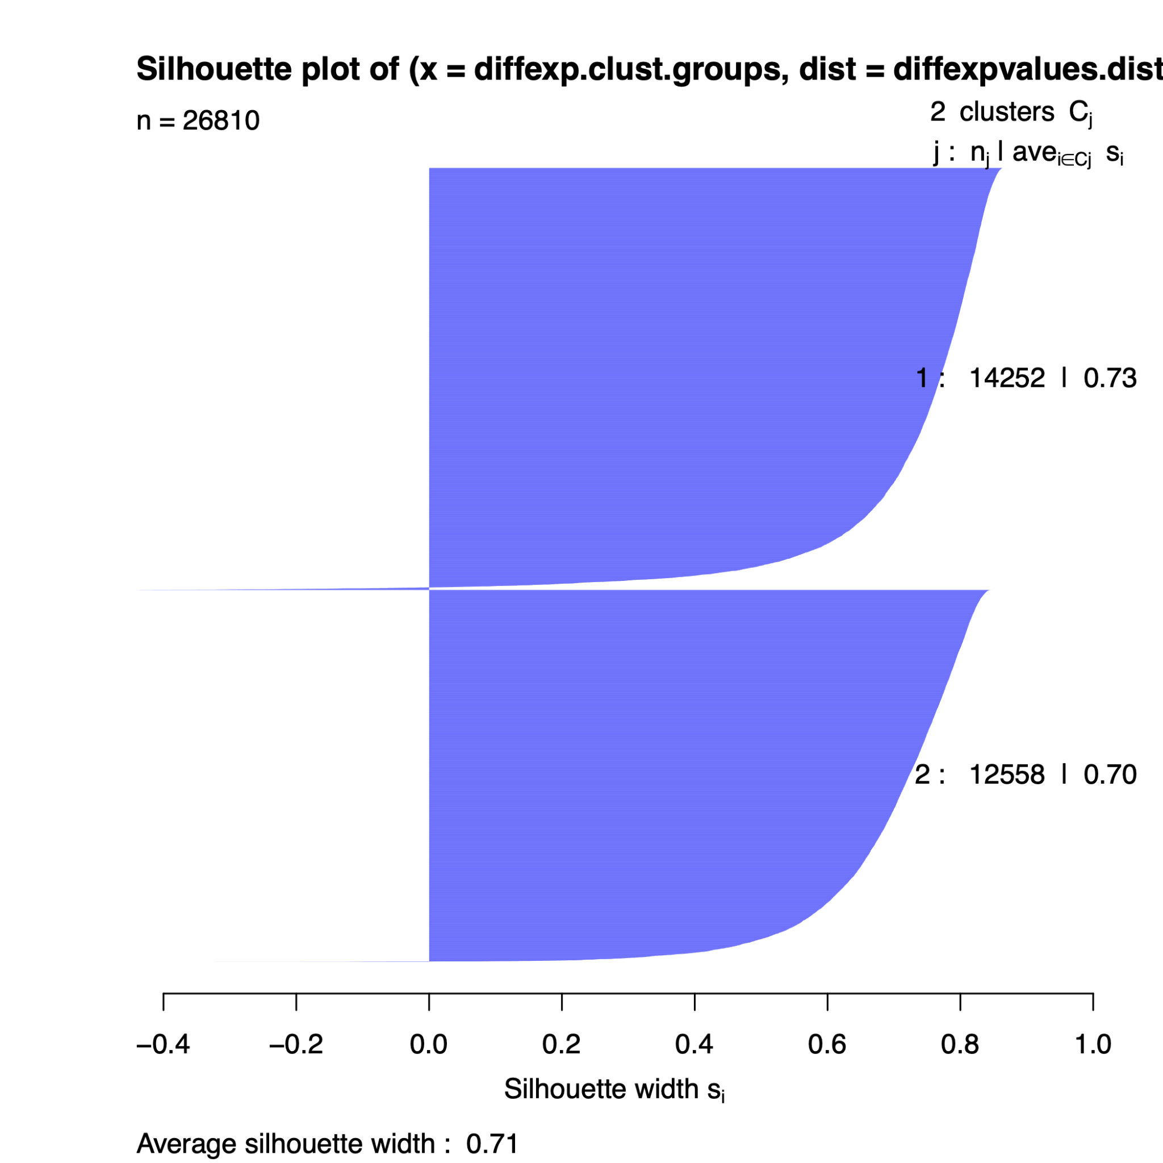
Clustering of Differentially Expressed Genes - Methods
Notes:
For cell and int terms, 2 groups are chosen. For condition term, 3 is chosen

Slide 9
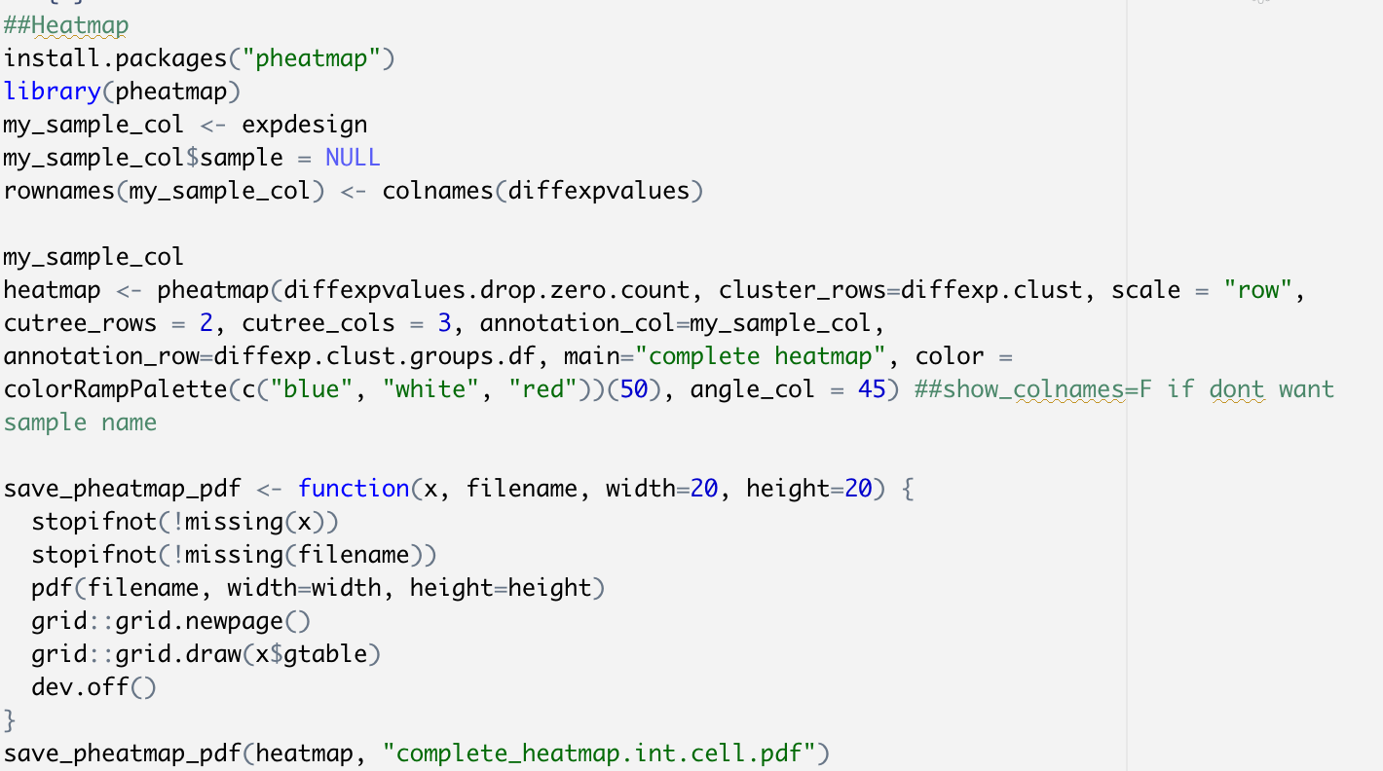
Clustering of Differentially Expressed Genes - Methods pt.2

Slide 10
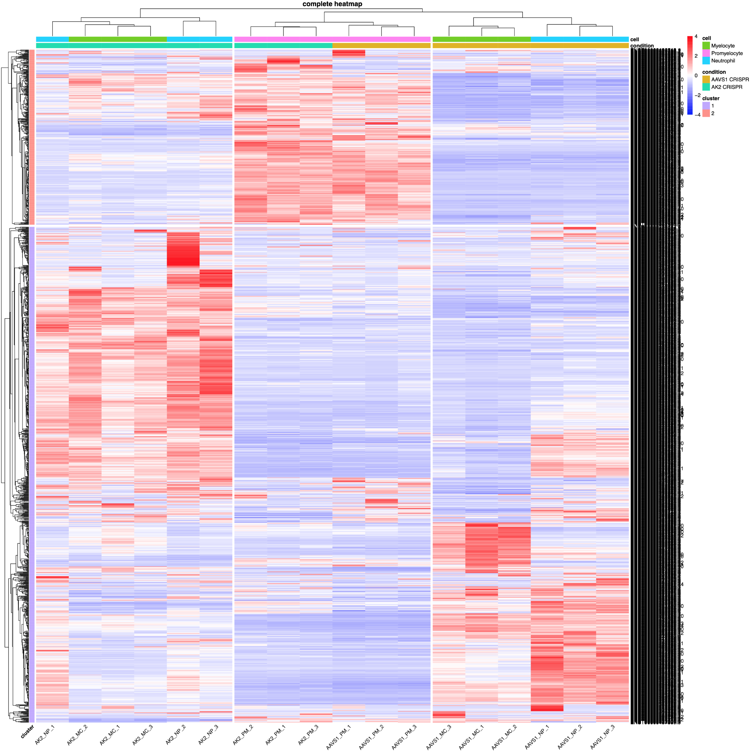
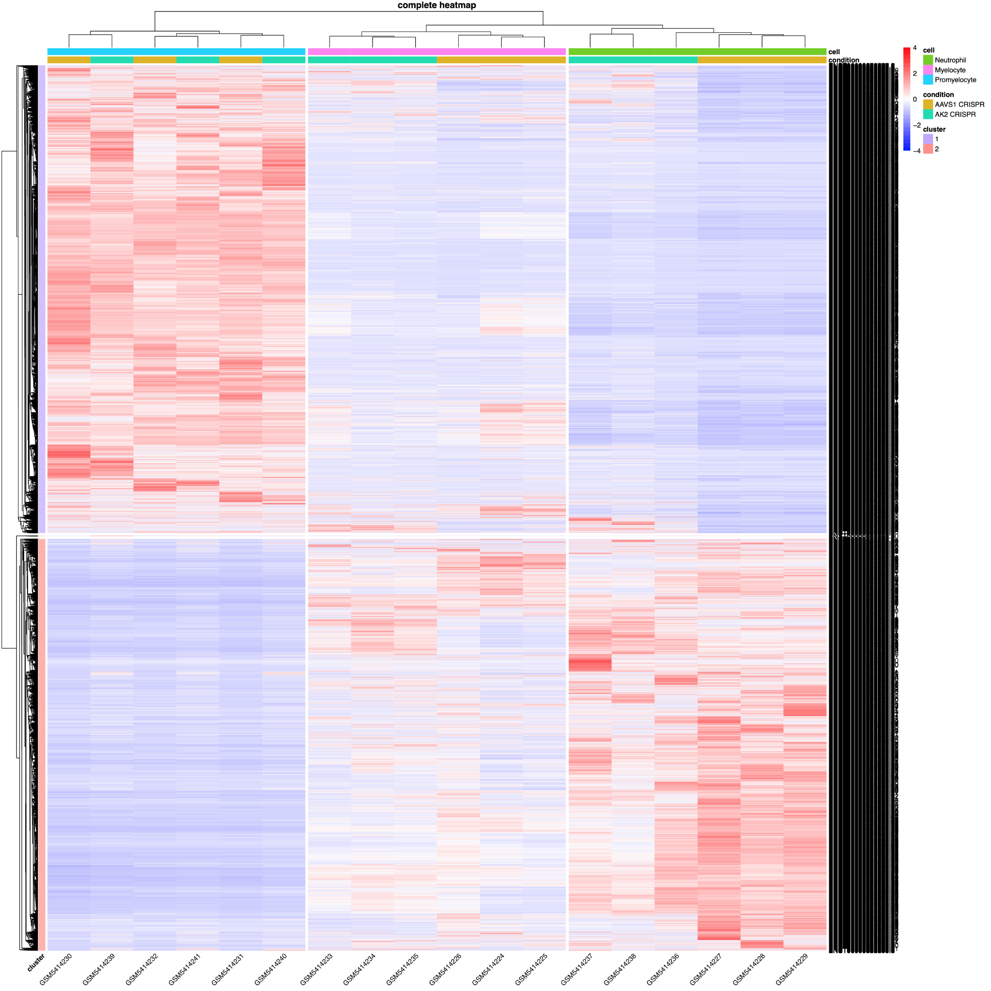
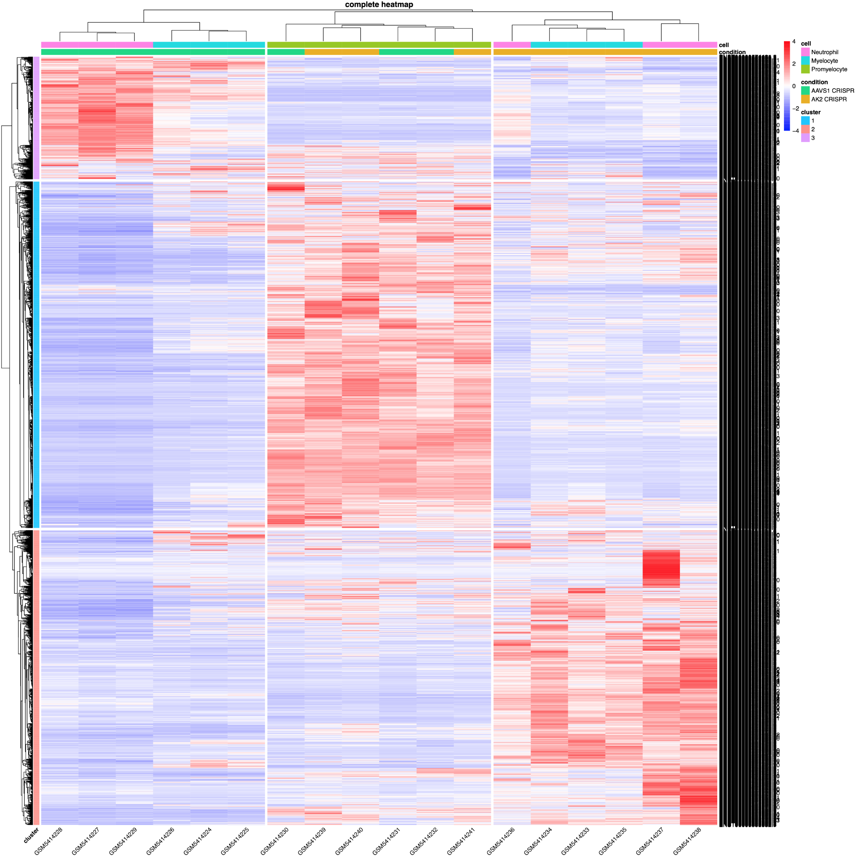
Clustering of Differentially Expressed Genes - Results
A) Interaction
B) Cell
C) Condition
Notes:
Interaction: cluster1- Pro has distinct higher exp, not related to condition while neu+mye has low exp in AAVS1 and relatively higher exp in AK2; cluster2-partial genes in AK2 demonstrate higher exp for neu+mye while rest of most genes in AAVS1 shows higher exp
Cell: cluster 1- pro has higher exp for bothe AAVS1 and AK2 meaning those genes are constitutively exp regardless of condition; cluster 2- neu in similar pattern
Condition: cluster1- neu in aavs1 high exp while low in AK2 meaning genes specifically control for neu is suppressed in AK2; cluster2-pro in high exp regardless condition; cluster3- some genes for neu+mye in AK2 highly exp

Slide 11
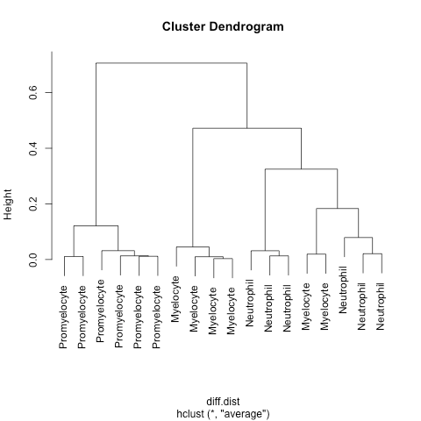
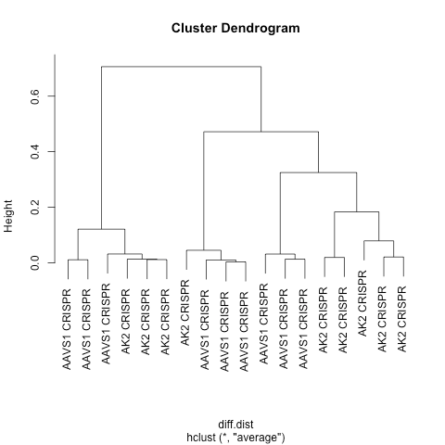
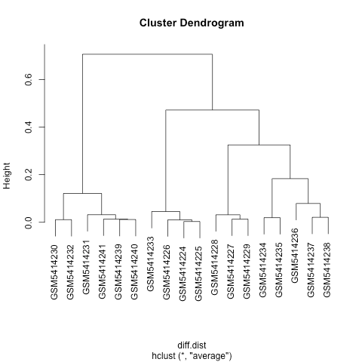
Clustering of Differentially Expressed Genes - Results pt.2
A) Cell
B) Condition
C) Sample
Notes:
Some clusters are not grouped with same condition so as by samples, great with cell types

Slide 12
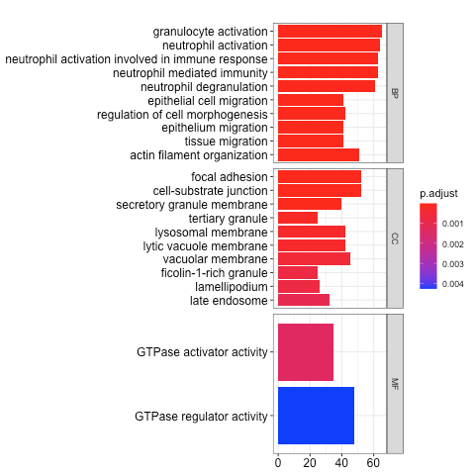
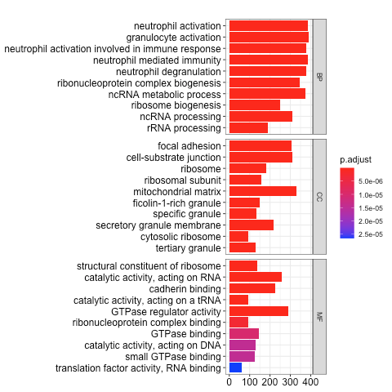
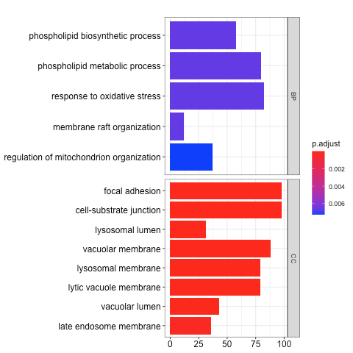
GO-term enrichment of Differentially Expressed Genes
A) Interaction
B) Cell
C) Condition

Slide 13
Conclusion
From the generated heatmaps, interesting to see at which cell stage exhibits higher expression
GO enrichment analysis helps understand the processes and pathways that are affected under each condition and within its different levels.
Higher expression of transcripts under AK2 condition is responsible for activating the immune response
oxidative stress which can eventually lead to apoptosis
Heatmap data supports the GO term enrichment which explains the effect on myelopoiesis
Notes:
understand why AK2 is depleted and how that affects myelopoiesis and its metabolic pathway. Detecting any pattern from the cells would be telling in how they affect any downstream processes they are involved in. RNA-seq of granulocytes derived from control and AK2 depleted human HSPCs

Slide 14
References
Myelopoiesis | Pathology Made Simple. (n.d.). Retrieved August 22, 2021, from http://ilovepathology.com/myelopoiesis/
Reticular dysgenesis | Genetic and Rare Diseases Information Center (GARD) – an NCATS Program. (n.d.). Rarediseases.info.nih.gov. Retrieved August 22, 2021, from https://rarediseases.info.nih.gov/diseases/8625/reticular-dysgenesis
Wenqing Wang, Avni Awani, Andrew Devilbiss, Thomas Mathews, Daniel Thomas, Daniel P. Dever, Matthew Porteus, Sean Morrison, Katja G Weinacht, Adenylate Kinase 2 Links Energy Metabolism and Cell Fate in Hematopoietic Stem and Progenitor Cells, Blood, Volume 134, Supplement 1, 2019, Page 3705, ISSN 0006-4971, https://doi.org/10.1182/blood-2019-129424. (https://www.sciencedirect.com/science/article/pii/S0006497118616337)

Slide 15
Questions??

